Slide 1

Networks and Cloud Computing
Pertemuan 6
Dr. Dedi Trisnawarman

Slide 2
Network Fundamentals
A computer network consists of communications media, devices, and software connecting two or more computer systems or devices
Communications media are any material substance that carries an electronic signal to support communications between a sending and a receiving device

Slide 3
Network Topology
In a star network, all network devices connect to one another through a single central device called the hub node.
In a bus network, all network devices are connected to a common backbone that serves as a shared communications medium.
Mesh networks use multiple access points to link a series of devices that
speak to each other to form a network connection across a large area.

Slide 4
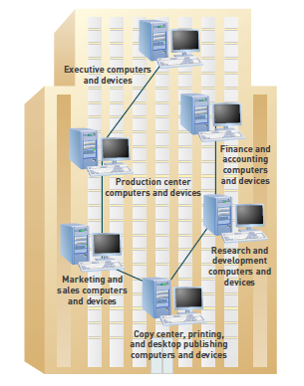
Network Types
Personal Area Network - A personal area network (PAN) is a wireless network that connects devices close to one person.
Local Area Network - A network that connects computer systems and devices within a small area
Metropolitan Area Network - a network that connects users and their computers in a geographical area
Wide Area Network - is a network that connects large geographic regions.

Slide 5
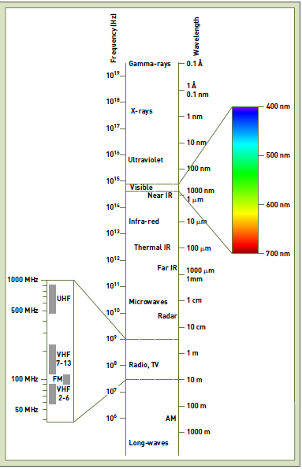
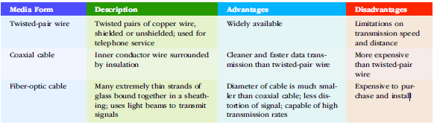
Communications Media
Guided transmission
Wireless communication

Slide 6
Application Programming Interface (API)
application programming interface (API): A set of programming instructions and standards that enables one software program to access and use the services of another software program.
hardware independence: The ability of a software program to run on any platform, without concern for the specific underlying hardware.

Slide 7
The Internet and World Wide Web
The cables, routers, switching stations,communication towers, and satellites that make up these networks are thehardware over which Internet traffic flows. The combined hardware of these and other NSPs—the fiber-optic cables that span the globe over land and under sea—make up the Internet backbone.
Each computer on the Internet has an assigned address, called its IPaddress, that identifies it on the Internet. An IP address is a 64-bit numberthat identifies a computer on the Internet.
A Uniform Resource Locator (URL) is a Web address that specifies theexact location of a Web page using letters and words that map to an IPaddress and a location on the host.

Slide 8
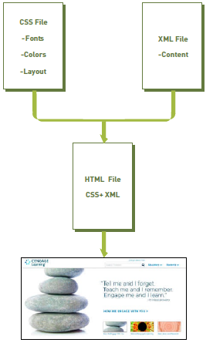
How the Web Works
Internet are accessed and viewed using Web client software called a Web browser.
Hypertext Markup Language (HTML) is the standard page description language for Web pages.
Extensible Markup Language (XML) is a markup language for Web documents containing structured information
Cascading Style Sheet (CSS) is a file or portion of an HTML file that defines the visual appearance of content in a Web page.

Slide 9
Intranets and Extranets
An intranet is an internal corporate network built using Internet and World Wide Web standards and products.
A growing number of companies offer limited network access to selected customers and suppliers. Such networks are referred to as extranets, which connect people who are external to the company.
virtual private network (VPN), a secure connection between two points on the Internet.

Slide 10
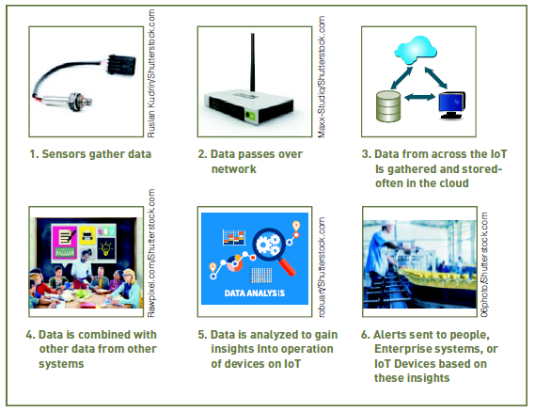
The Internet of Things
The Internet of Things (IoT) is a network of physical objects or “things” embedded with sensors, processors, software, and network connectivity capability to enable them to exchange data with the manufacturer

Slide 11
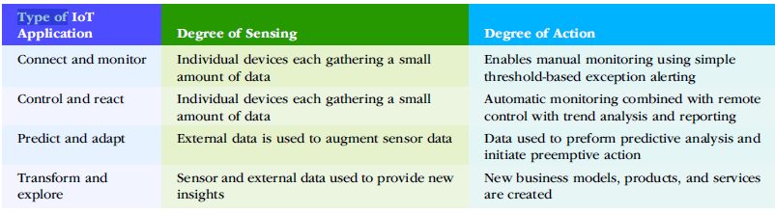
Types of IoT applications

Slide 12
Cloud Computing
Cloud computing refers to a computing environment in which software and storage are provided as an Internet service and accessed by users with their Web browser.

Slide 13
Public Cloud Computing
In a public cloud computing environment, a service provider organization owns and manages the infrastructure (including computing, networking, and storage devices) with cloud user organizations (called tenants) accessing slices of shared hardware resources via the Internet.

Slide 14
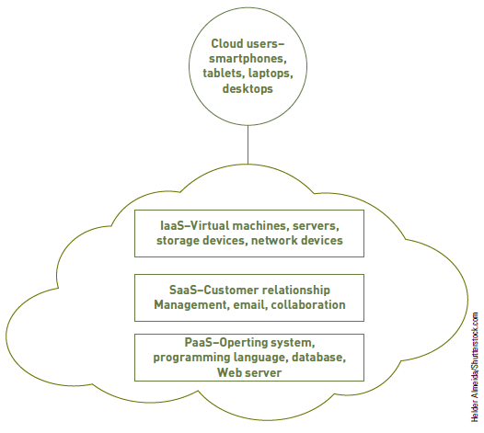
Private & Hybrid Cloud Computing
A private cloud environment is a single tenant cloud. Organizations that implement a private cloud often do so because they are concerned that their data will not be secure in a public cloud
A hybrid cloud is composed of both private and public clouds integrated through networking.

Slide 15
Cloud computing type of services
Infrastructure as a service (IaaS) is an information systems strategy in which an organization outsources the equipment used to support its data processing operations, including servers, storage devices, and networking components.
Software as a service (SaaS) is a software delivery approach that provides users with access to software remotely as a Web-based service.
Platform as a service (PaaS) provides users with a computing platform, typically including operating system, programming language execution environment, database services, and a Web server

